Slide 1

Quantum Gambling Simulator
- Monty Hall Problem
- Prisoner’s Dilemma
Team Bird Vodka
Bryan Yuan (UCSD)
Chris Chen (UCI)
Elvin Lin (UCI)
Haotian Wang (UCI)
Ke Xu (UCI)
We would only illustrate the Monty Hall problem due to page limits!

Slide 2
Classical Monty Hall Problem
Rules:
Alice prepares three identical doors.
Alice randomly puts a ball behind one of the doors.
Bob chooses a door.
Alice opens another door, showing no ball behind that door.
Bob decides whether to switch his choice to the remaining door.
Alice opens the door Bob chose.
Bob wins if he chose the door with ball; Alice wins if Bob didn’t.
Bob has 2/3 win rate if he always switches. This result was counter-intuitive!
This game is biased to Bob, because the only strategy space for Alice is choosing the ball’s initial position, while Bob’s choice would not affect

Slide 3
Quantum Monty Hall Problem
Our inspiration is from these two papers:
Quantum strategies of quantum measurements
Quantum version of the Monty Hall problem
We produced our own rules to the game!
The rules design strategy of our Quantum Monty Hall problem is aiming for two goals:
It converges to classical case when we limit the choice space from linear combinations of bases to bases only.
It eliminates the unfairness of the classical game

Slide 4
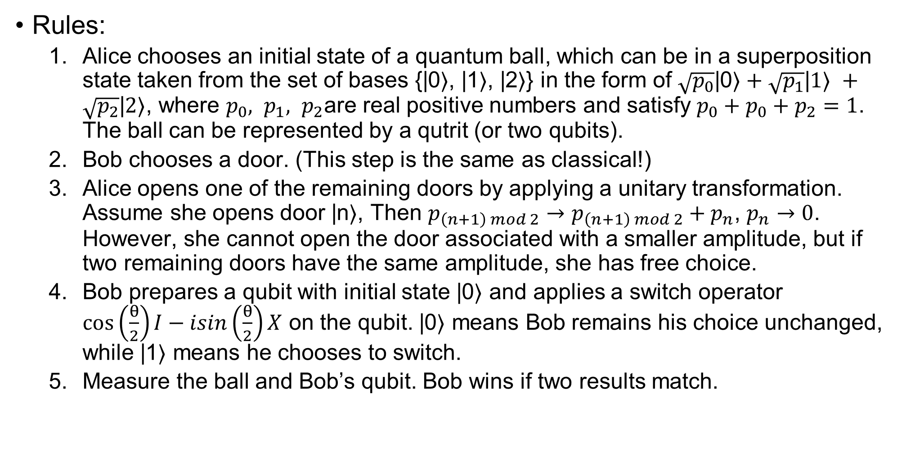
Quantum Monty Hall Problem
Rules:
Alice chooses an initial state of a quantum ball, which can be in a superposition state taken from the set of bases {|0⟩, |1⟩, |2⟩} in the form of $\sqrt{p_{0}}\text{|}\text{0}\text{⟩}+\sqrt{p_{1}}\text{|}1\text{⟩} +\sqrt{p_{2}}\text{|}2\text{⟩}$, where $p_{0}, p_{1}, p_{2}$are real positive numbers and satisfy $p_{0}+p_{0}+p_{2}=1$. The ball can be represented by a qutrit (or two qubits).
Bob chooses a door. (This step is the same as classical!)
Alice opens one of the remaining doors by applying a unitary transformation. Assume she opens door |n⟩, Then $p_{\left(n+1\right) mod 2}→p_{\left(n+1\right) mod 2}+p_{n}$, $p_{n}→0$. However, she cannot open the door associated with a smaller amplitude, but if two remaining doors have the same amplitude, she has free choice.
Bob prepares a qubit with initial state |0⟩ and applies a switch operator $\cos\left(\frac{θ}{2}\right)I−isin\left(\frac{θ}{2}\right)X$ on the qubit. |0⟩ means Bob remains his choice unchanged, while |1⟩ means he chooses to switch.
Measure the ball and Bob’s qubit. Bob wins if two results match.

Slide 5
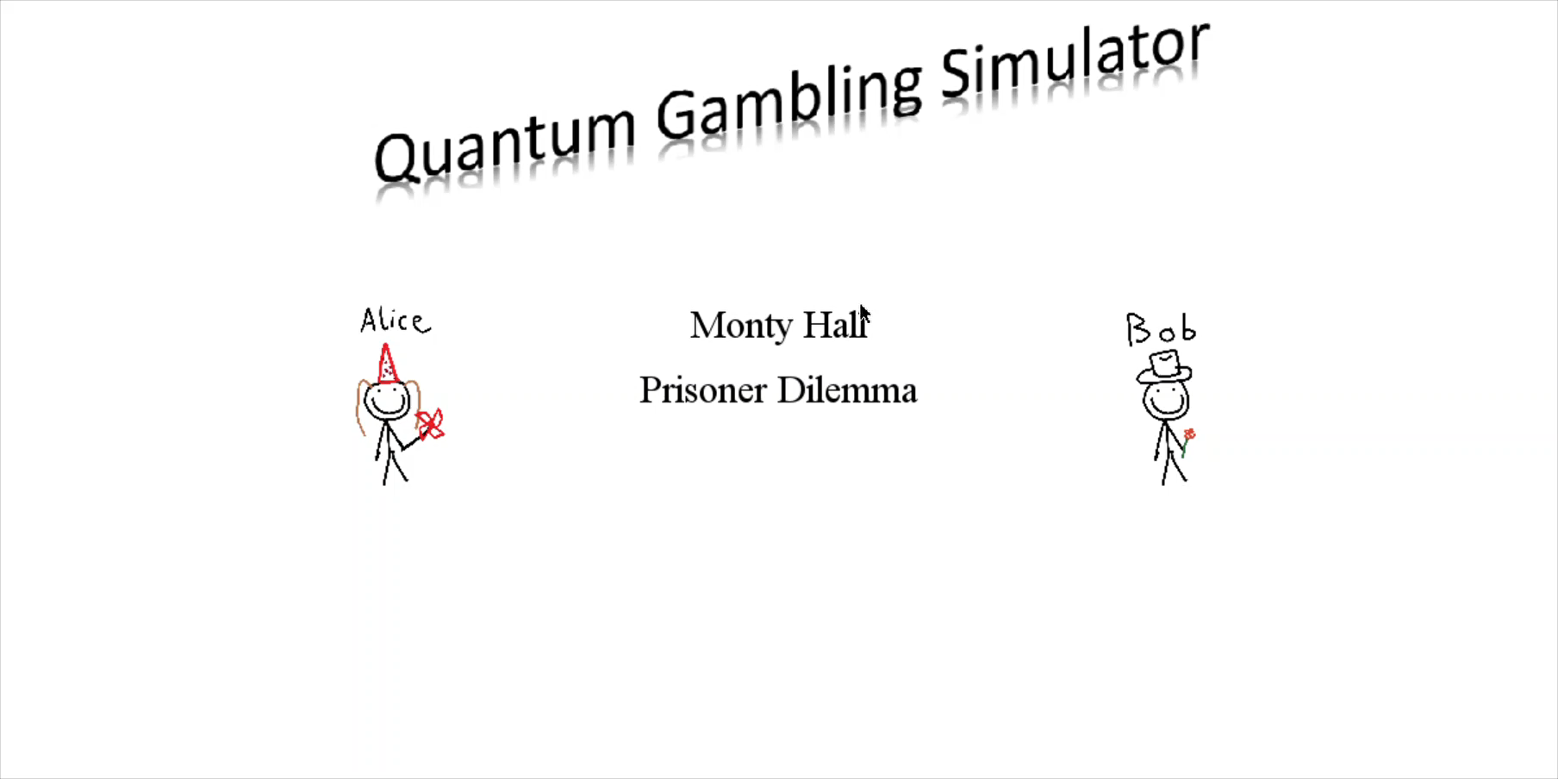
User Interface

